Slide 1
CS639: Data Management for Data Science
Lecture 1: Intro to Data Science and Course Overview
Theodoros Rekatsinas

Slide 3
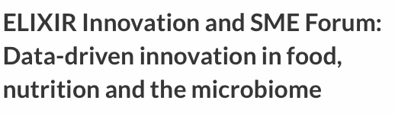
Big science is data driven.

Slide 4
Increasingly many companies see themselves as data driven.

Slide 5
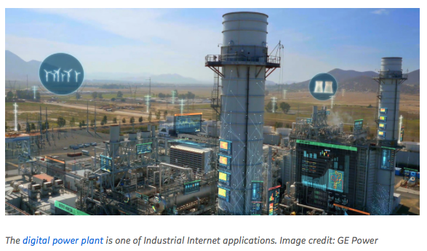
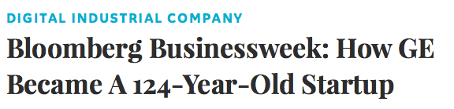
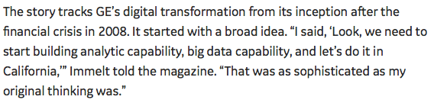
Even more “traditional” companies…

Slide 6
The world is increasingly driven by data…
This class teaches the basics of how to use & manage data to obtain useful insights.

Slide 7
Today’s Lecture
Motivation, Admin, & Setup
Introduction to Data Science

Slide 8
1. Motivation, Admin & Setup
Section 1

Slide 9
What you will learn about in this section
Section 1
Motivation for studying Data Science
Administrative structure
Course logistics

Slide 10
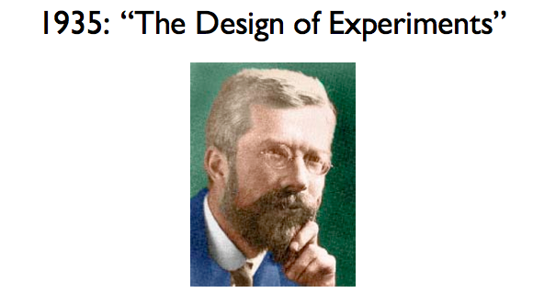
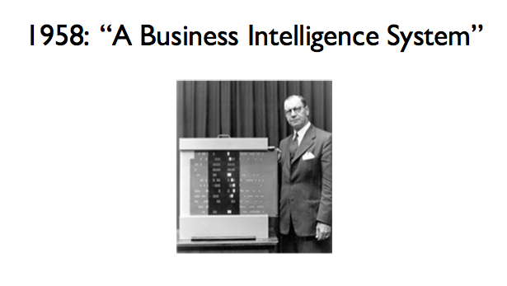
Data Analysis has always been around
Section 1
R.A. Fisher
“Correlation does not imply causation”
A pioneer in hash coding and full text processing
Coined the term “business intelligence”
Peter Luhn

Slide 11
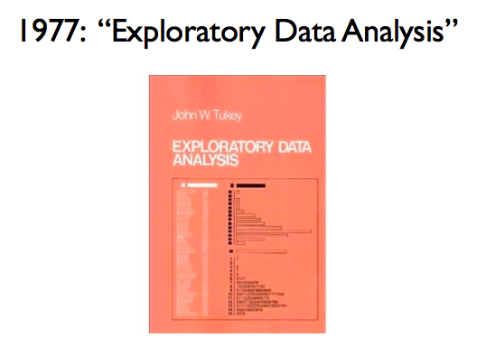
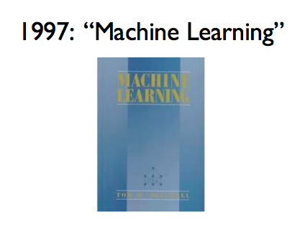
Data Analysis has always been around
Section 1
John Tukey
Introduced the box-plot
Also introduced the term “bit” (later used by Shannon)
The time of data-driven AI
Tom Mitchell

Slide 12
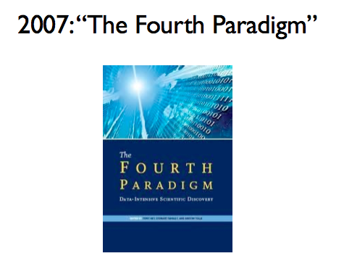
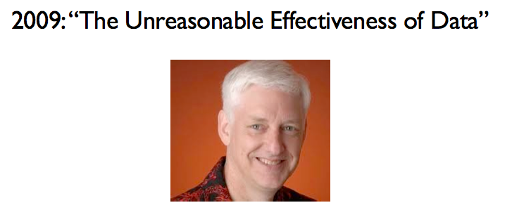
Data Analysis has always been around
Section 1
Essays on Scientific Discovery based on data-intensive science
Father of ACID
(requirements for reliable transaction processing)
By Jim Gray
Known for AI programming
(at Google)
Peter Norvig

Slide 13
Data Analysis is popular
Section 1

Slide 14
Why should you study data science?
Section 1
Mercenary-make more $$$:
Startups need data science talent right away = low employee #
Massive industry…
Intellectual:
Science: data poor to data rich
No idea how to handle the data!
Fundamental ideas to/from all of CS:
Systems, theory, AI, logic, stats, analysis….

Slide 15
What this course is (and is not)
Section 1
Discuss the fundamentals data management for data science workflows
How to represent and store data
How to extract and prepare data for analysis
How to analyze data and how to visualize and communicate insights
You will learn how to design data science pipelines
This is not a databases, systems, or machine learning class. We will touch many topics covered in these classes but we will not go into details.

Slide 16
Who we are…
Section 1
Instructor (me) Theo Rekatsinas
Faculty in the Computer Sciences and part of the UW-Database Group
Research: data integration and cleaning, statistical analytics, and machine learning.
thodrek@cs.wisc.edu
Office hours: MWF after class @CS 4361

Slide 17
Section 1
Huawei Wang
Frank Zou

Slide 18
Communication w/ Course Staff
Section 1
The goal is to get you to answer each other’s questions so you can benefit and learn from each other.
Piazza https://piazza.com/wisc/spring2019/cs639
Class mailing list: compsci639-4-s19@lists.wisc.edu
Office hours: Listed on the website
Also By appointment!

Slide 19
Course Website: https://thodrek.github.io/cs639_spring19/
Section 1
Course Github: https://github.com/thodrek/cs639_spring19

Slide 20
Lectures
Section 1
Lecture slides cover essential material
This is your best reference.
We will have pointers as needed
Recommended textbooks listed on website
Try to cover same thing in many ways: Lecture, lecture slides, homework, exams (no shock)
Attendance makes your life easier…

Slide 21
Graded Elements
Section 1
Six Programming assignments (45%)
Focus on different aspects of data science
Midterm (20%)
Final exam (35%)
Dates are posted on the website!!!

Slide 22
What is expected from you
Section 1
Attend lectures
If you don’t, it’s at your own peril
Be active and think critically
Ask questions, post comments on forums
Do programming projects
Start early and be honest
Study for tests and exams

Slide 23
Programming Assignments
Section 1
Six programming assignments
Python plus Jupiter notebooks
These are individual assignments
Submission via Canvas
~1 week per programming assignments
Ask questions, post comments on forums
Start early!
You have late days. The policy is described on the website

Slide 24
Programming setup for class
Section 1
For all assignments we will use the provided Virtual Machine.
Ubuntu + necessary python libraries
Link provided on the website
We will not provide support for any other platform (you can still use your own machine)
To deploy and run the provided VM:
Download and Install Virtual Box: https://www.virtualbox.org/wiki/Downloads
Download the Class VM from: https://www.dropbox.com/s/xjvj3jlaurzjfas/cs639_vm.ova.zip?dl=0
Import the VM by following the instructions here: https://blogs.oracle.com/oswald/importing-a-vdi-in-virtualbox
Run the VM and login with the following credentials:
Username: CS639_DS_USER
Password: cs639_ds_user
Come to office hours if you need help with installation!
Please help out your peers by posting issues / solutions on Piazza!

Slide 25
2. Introduction to Data Science
Section 2

Slide 26
What you will learn about in this section
Section 2
What is Data Science?
Data Science workflows
What should a Data Scientist know?
Overview of lecture coverage

Slide 27
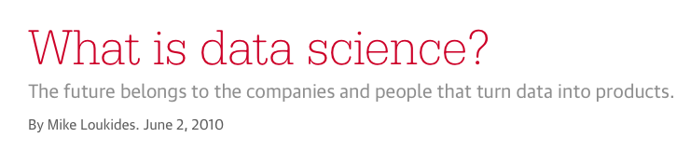
Data Science is an emerging field
Section 2
https://www.oreilly.com/ideas/what-is-data-science

Slide 28
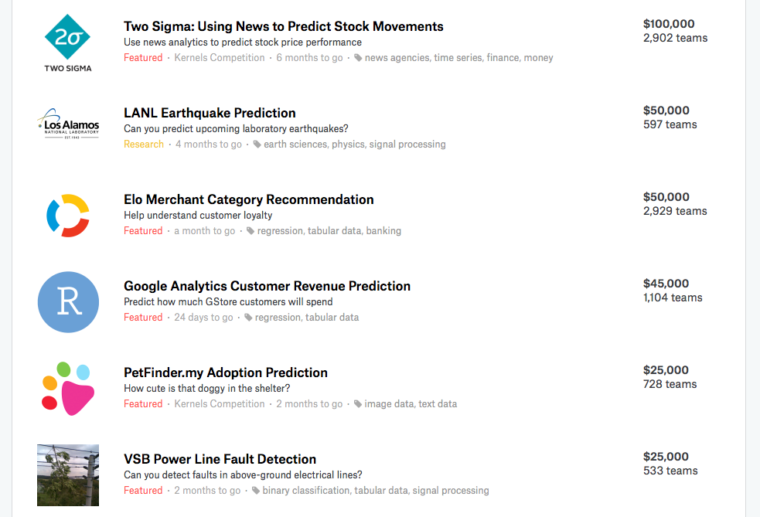
Data Science products
Section 2

Slide 29

One definition of data science
Section 2
Data science is a broad field that refers to the collective processes, theories, concepts, tools and technologies that enable the review, analysis and extraction of valuable knowledge and information from raw data.
Source: Techopedia

Slide 30
Data science is not databases
Section 2
 | Databases | Data Science
Data Value | “Precious” | “Cheap”
Data Volume | Modest | Massive
Examples | Bank records, Personnel records, Census, Medical records | Online clicks, GPS logs, Tweets, Building sensor readings
Priorities | Consistency, Error recovery, Auditability | Speed, Availability, Query richness
Structured | Strongly (Schema) | Weakly or none (Text)
Properties | Transactions, ACID* | CAP* theorem (2/3), eventual consistency
Realizations | SQL | NoSQL: Riak, Memcached, MongoDB, CouchDB, Hbase, Cassandra,…
ACID = Atomicity, Consistency, Isolation and Durability
CAP = Consistency, Availability, Partition Tolerance

Slide 31
Data science is not databases
Section 2
Databases | Data Science
Querying the past | Querying the future
Business intelligence (BI) is the transformation of raw data into meaningful and useful information for business analysis purposes. BI can handle enormous amounts of unstructured data to help identify, develop and otherwise create new strategic business opportunities - Wikipedia

Slide 32
Data science workflow
Section 2
https://cacm.acm.org/blogs/blog-cacm/169199-data-science-workflow-overview-and-challenges/fulltext

Slide 33
Data science workflow
Section 2

Slide 34
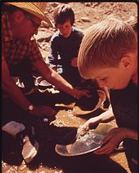
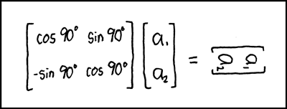
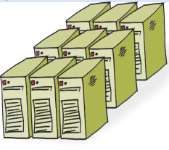
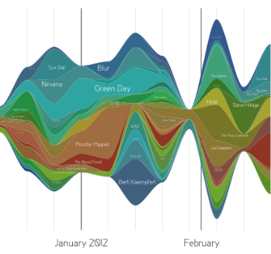
Data science workflow
Section 2
Clean,
prep
Hypothesize Model
Large Scale Exploitation
Digging Around in Data
Evaluate Interpret

Slide 35
What is hard about Data Science
Section 2
Overcoming assumptions
Making ad-hoc explanations of data patterns
Overgeneralizing
Communication
Not checking enough (validate models, data pipeline integrity, etc.)
Using statistical tests correctly
Prototype → Production transitions
Data pipeline complexity (who do you ask?)
Notes:
Quote from paper “I’d rather the data go away than be wrong and not know”
Assumptions not communicated: transformations not documented.

Slide 36
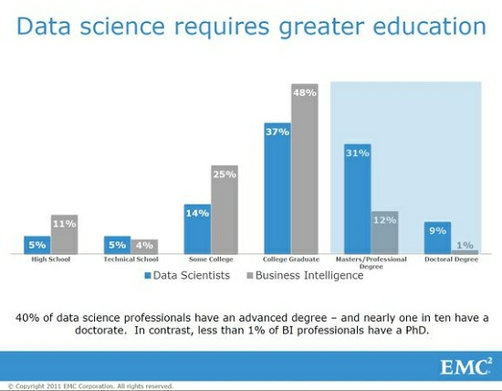
What is hard about Data Science
Section 2
Notes:
Quote from paper “I’d rather the data go away than be wrong and not know”
Assumptions not communicated: transformations not documented.

Slide 37
What is hard about Data Science
Section 2

Slide 38
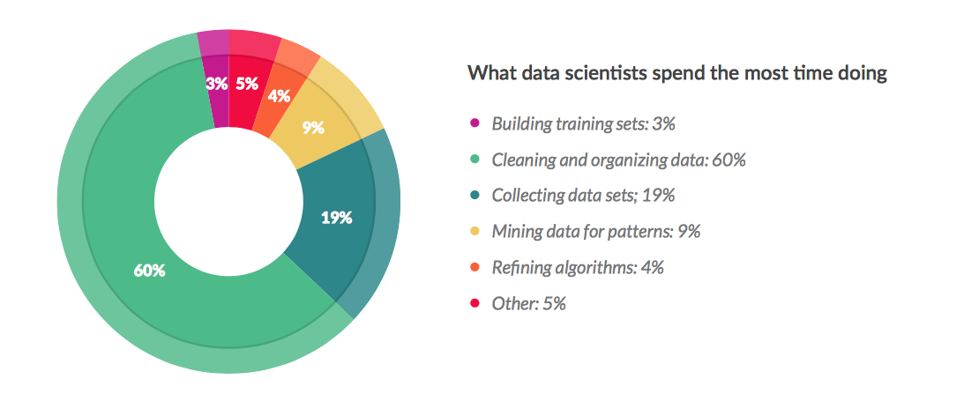
What are Data Scientists really doing?
Section 2
https://visit.figure-eight.com/rs/416-ZBE-142/images/CrowdFlower_DataScienceReport_2016.pdf

Slide 39
Lectures: 1st part – Data Storage
Section 2
Overview: What is data science
Lectures 1-3
Foundations: Relational data models & SQL
Lectures 4-7
How to manipulate data with SQL, a declarative language
reduced expressive power but the system can do more for you
Query optimization
MapReduce and NoSQL systems: MapReduce, KeyValue Stores, Graph DBs
Lectures 8-14
Dealing with massive amounts of data and non-relational data

Slide 40
Lectures: 2nd part – Predictive analytics
Section 2
4. Statistical Reasoning: Inference, Sampling Bayesian Methods
Lectures 15-17
How to reason about patterns in data
5. Machine Learning: Decision Trees, Evaluation of ML models, Ensembles
Lectures 18-22
Overview of different ML paradigms
6. Optimization: How to train ML models (efficiently)?
Lecture 23
Loss Functions, Optimization via Gradient Descent
Stochastic Gradient Descent (SGD), Parallel SGD

Slide 41
Lectures: 3rd part – Data Integration
Section 2
7. Information Extraction: Named entity recognition and relation extraction
Lecture 24
How to identify entities of interest in unstructured data?
How to find relationships between them?
8. Data Integration: Combine information from different data sources
Lecture 25
How to find if a real-world entity is mentioned in different sources?
How to align data from different sources?
9. Data Cleaning: Remove errors and noise from data
Lecture 26
How can we detect errors in data to be used for analytics?
How can we fix these errors automatically?

Slide 42
Lectures: 4th part – Communicating Insights
Section 2
10. Data Visualization: Creating data charts that convey interesting findings
Lectures 27-29
How to convey insights most effectively?
How to explore raw data?
11. Data Privacy: Sharing sensitive information
Lecture 30-32
How can we share sensitive data?
How can we perform analytics on sensitive data?

